Slide 1
Hot Taco
Project #3
Deliverable #1

Slide 2
Team Members
Bill Gannon
Finot Habteab
Colin Lawrence
Matt Sauermilch

Slide 3
Overview
Hot Taco: a MERN web app to help you enjoy one of Austin’s greatest resources – Tacos!
A single page app for finding new taco spots and sharing your experience.
Navigate a map of Austin with taco icons showing new spots to try. Click to find more info.
Rate and review your experience and add to your Taco History. Add a picture of your visit.

Slide 4

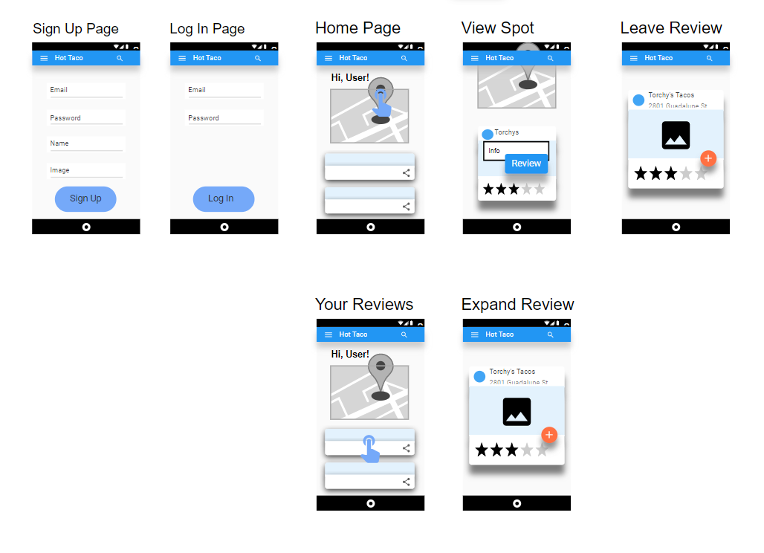
UI/UX Flow

Slide 5
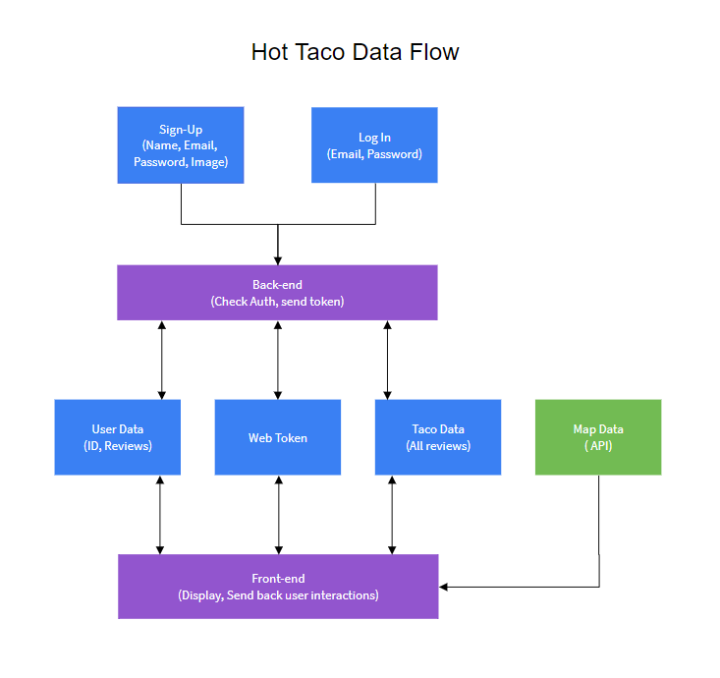
Data Flow

Slide 6
Roles
Bill – Deliverables, Documentation, Front-end
Finot – Front-end
Colin – User Auth, Back-end
Matt – APIs, Features

Slide 7
Schedule
Deliverable 1 – 5/18
Deliverable 2 – 5/25
Deliverable 3 – 5/29
Submit Powerpoint
Working basic Google Map
Working routes
Picture posting with url
User Auth – can create and login
MVP
Mini-presentation
Finish user auth and logout
Basic taco feed
Allow user image posting
Polish frontend
Final front end
Stretch features
Find other users
View other user pages
Heat Map / recommendations
Edit User Info

Slide 8
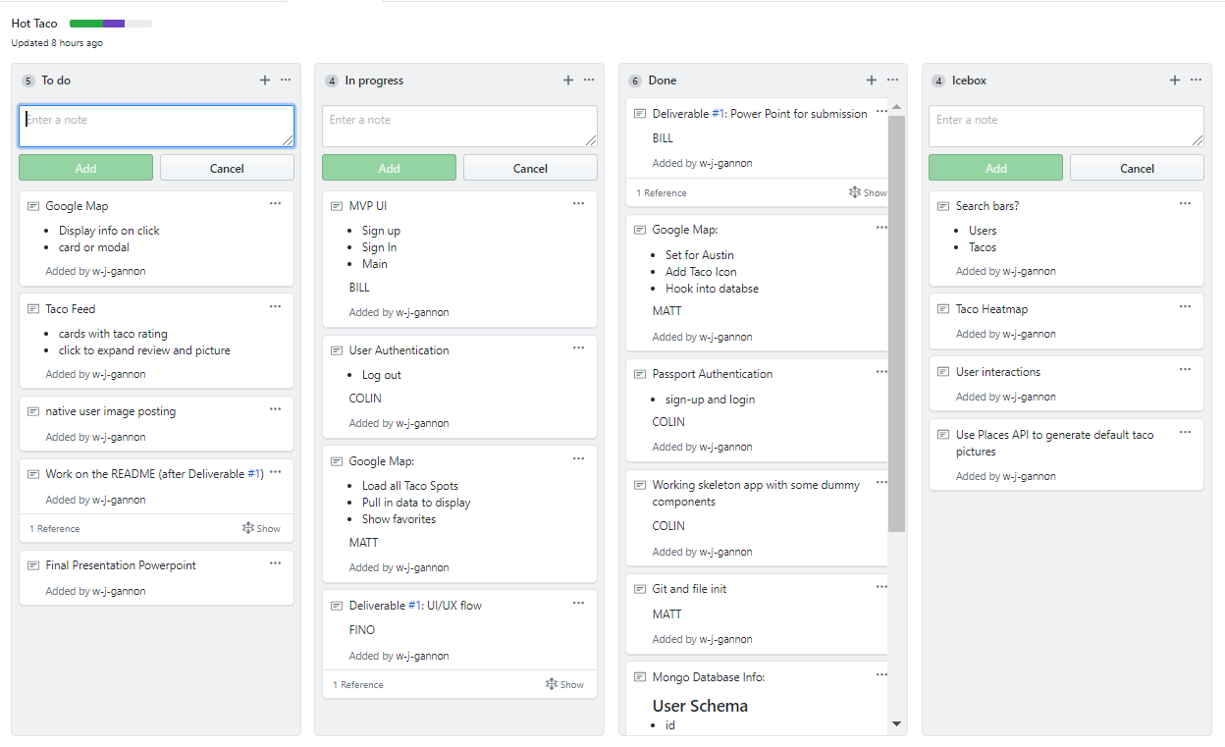
Kanban

